Slide 1
CAR# 173917065 Observation
Q8 to Q9 : Anne Deng

Slide 2
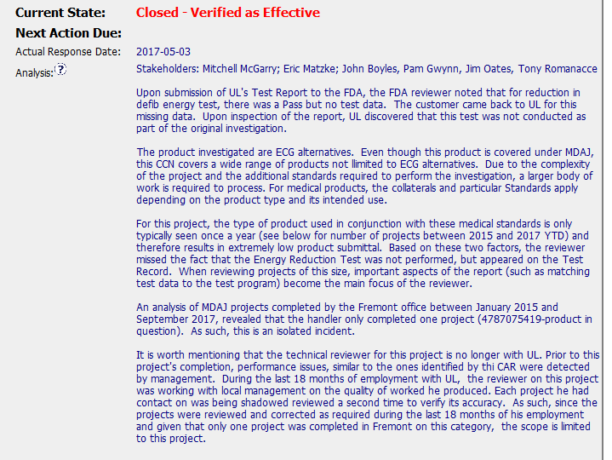
CAR# 173917065 – Anne Deng

Slide 3
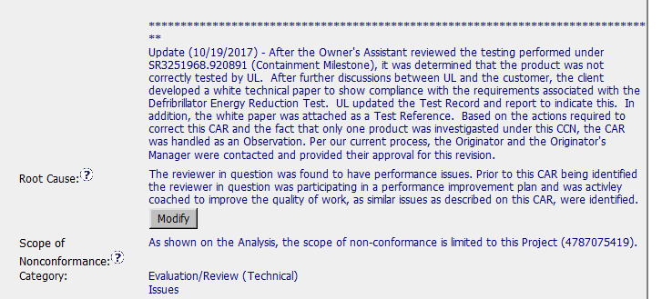
CAR# 173917065 – Anne Deng
Q8: Explain how/If the analysis supports the root cause statement.
Partially
-- Analysis part indicates the reviewer omitted to check if the Energy Reduction Test was performed due to few such kind of project handled and project’s complexity and the reviewer has performance issue.
-- But Root cause only states it was the reviewer performance issue , and the reviewer was participating a performance improvement plan and coached to improve the quality of work.
-- Suggest consider why the test did not perform the test as well.

Slide 4
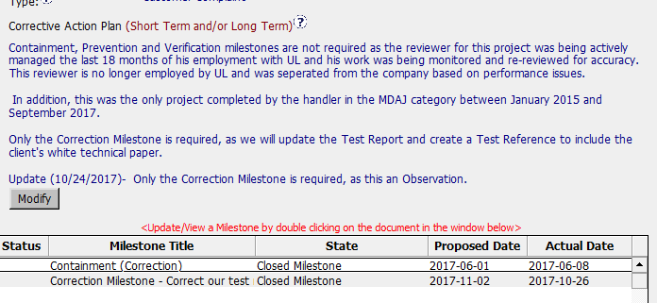
CAR# 173917065: Observation
Q9: Explain why/If the evidence in the milestones was sufficient to confirm that the nonconformity was eliminated.
Fully
-- The revised test report containing the correct rationale for not performing the Energy Reduction Defibrillator was reissued.
-- The Test Reference Form was created.

Slide 5
CAR# 173917065 – CAR Review Criteria Check
CAR Review Criteria | Fully | Partially | Not at all | N/A
Explain how/If the analysis supports the root cause statement
Explain why/If the evidence in the milestones was sufficient to confirm that the nonconformity was eliminated.
√
√

